Slide 1
Loops and mask residuals in the Cosmic Microwave Background
Adnan Jašarević
Mentors:
James Creswell
Amel Duraković

Slide 2
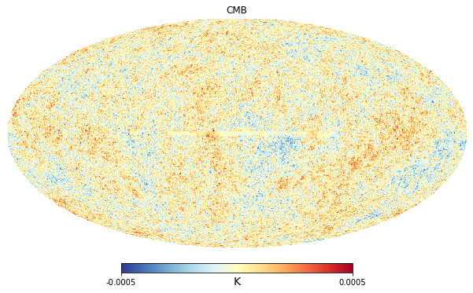
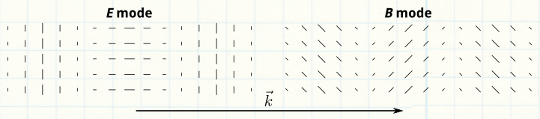
Planck (2009-2013)
Isotropic
Temperature map
Polarization

Slide 3
Investigation of the statistics of the CMB temperature and polarization
Effects of masking on polarization and how to remove these effects
The presence of loop correlations in the CMB

Slide 4
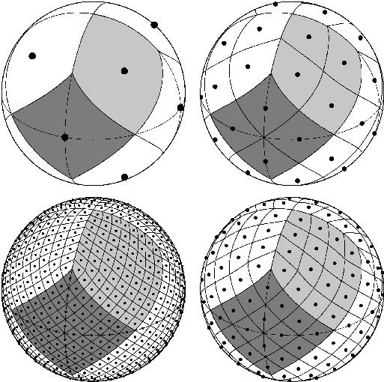
HEALPix
12
48
From raw data to the spherical projection in 2D
768
192

Slide 5
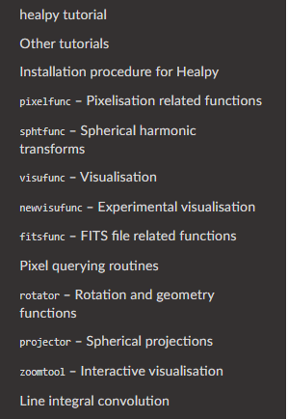
HEALPix
Healpy
Visualization of healpix maps
Modifying the resolution
Applying the Gaussian smoothing
Masking the map

Slide 6
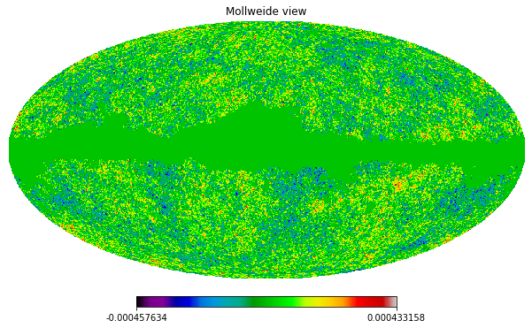
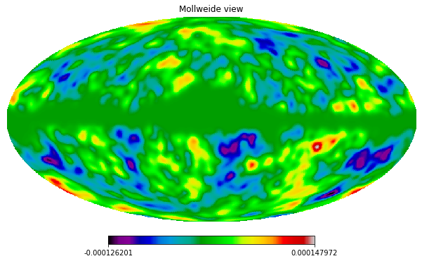
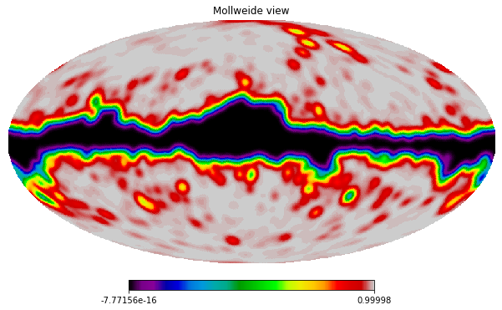
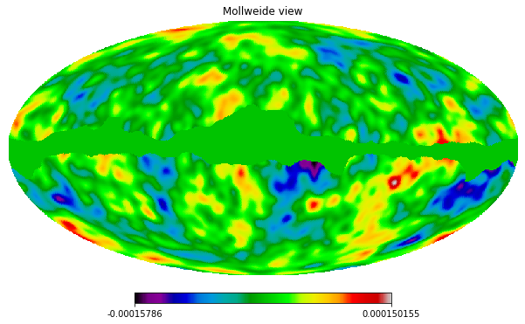
Galactic mask

Slide 7
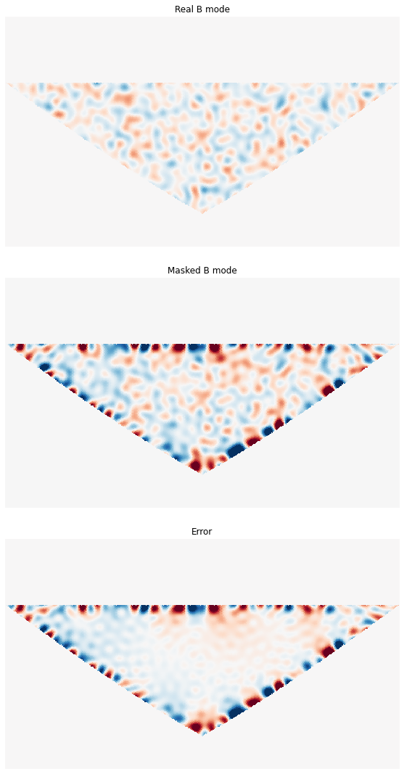
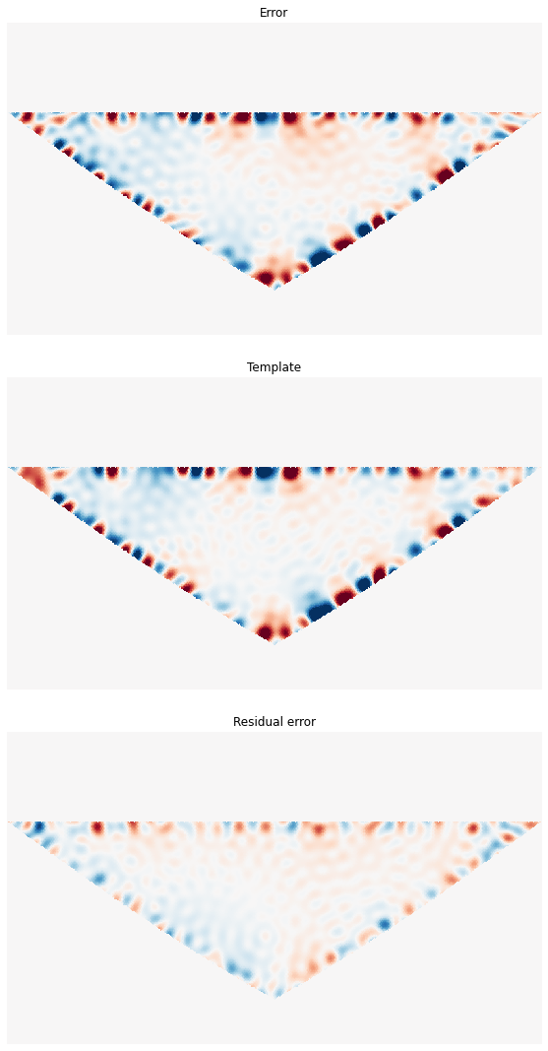
E-B leakage
Polarization

Slide 8
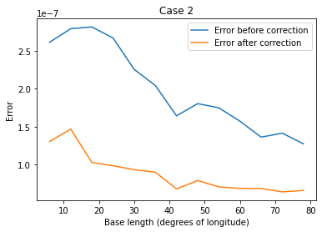

Slide 9
The presence of loop correlation in CMB
Actual map of temperature fluctuations
Defining the loop of exact angular distance and thickness
Sum all pixels in the loop
L map

Slide 10
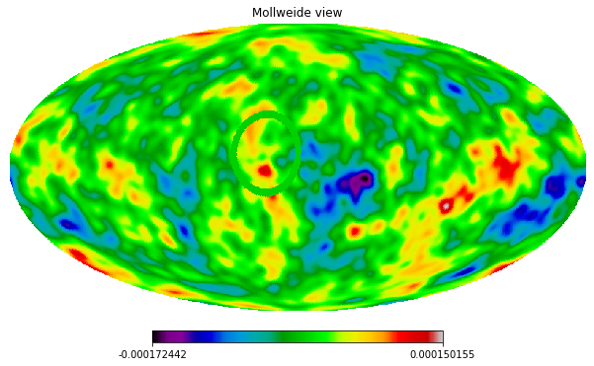

Slide 11
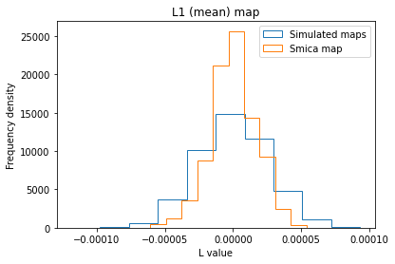
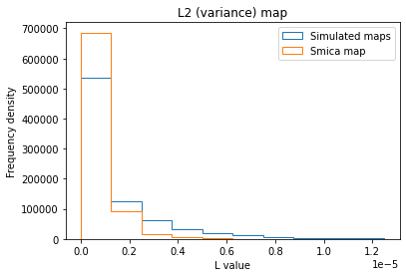
Loop (radius=20 degrees, thickness=2 degrees)

Slide 12
Conclusions
Error in EB leakage depends on the size of the mask
There seems to be loop correlation in CMB but not necessarily statistically significant

Slide 13
What comes next?
Investigate how masks of different shapes affect the reduction of error in EB leakage.
Implement the same method with many more simulations and with different loop sizes.

